Slide 1
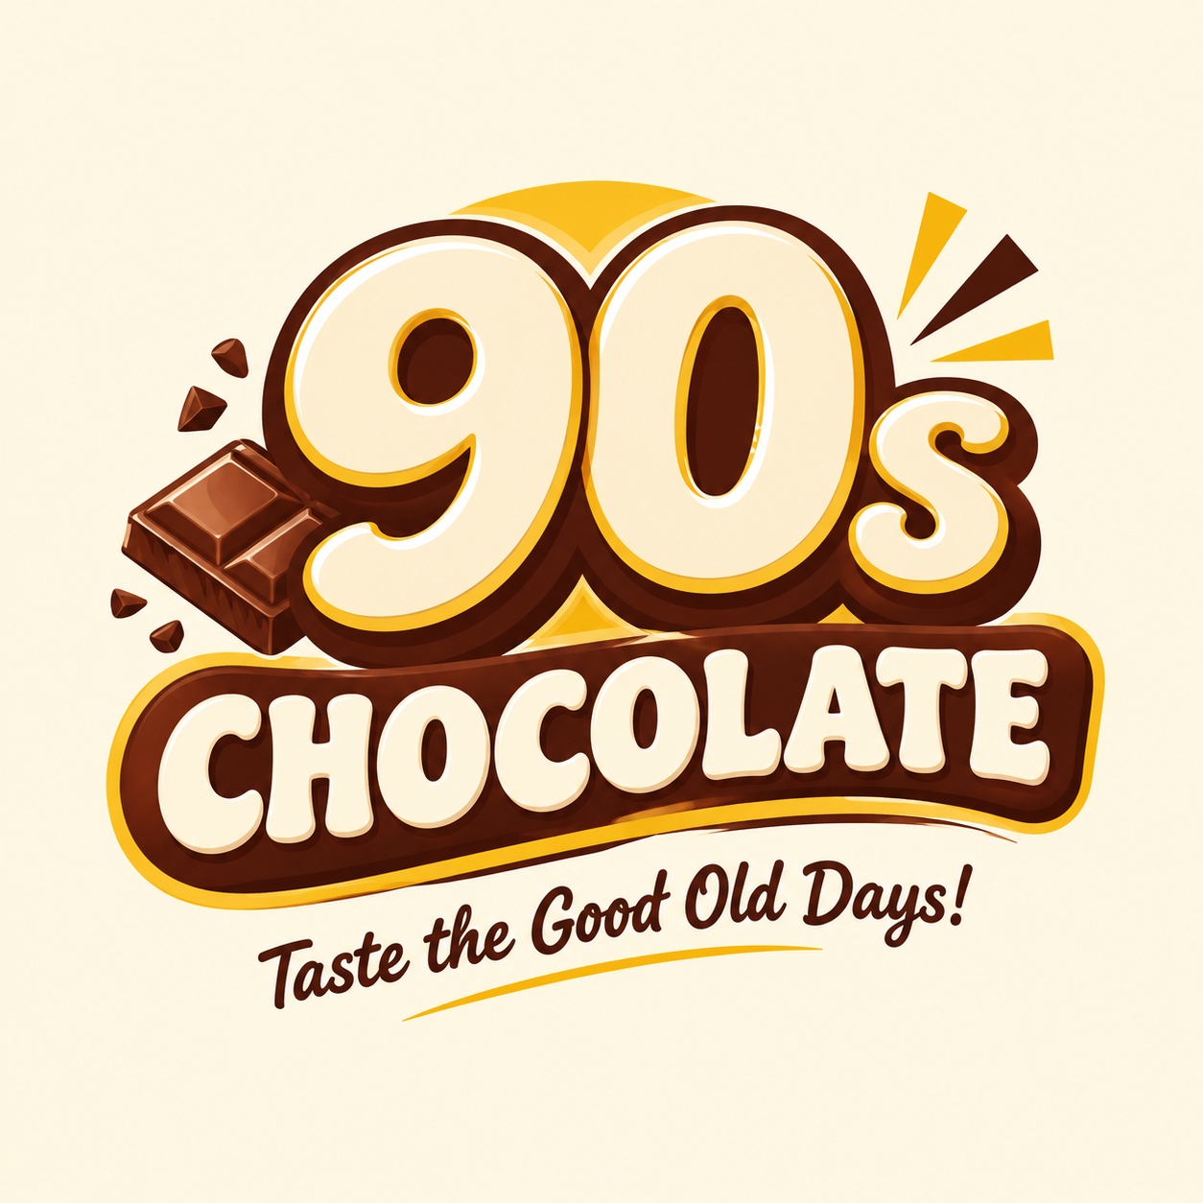
90s CHOCOLATE
AI MARKETING CAMPAIGN
Brand Identity • Social Media
Advertisement • Content Plan
Taste the Good Old Days!
A nostalgic chocolate campaign for college students and young adults.

Slide 2
01 | BRAND IDENTITY
Building a memorable chocolate brand
Brand Name
Target Audience
90s Chocolate
• College students
• Young adults
• Chocolate lovers
Slogan
Taste the Good Old Days!
Brand Personality
• Nostalgic
• Friendly
• Fun and shareable
2

Slide 3
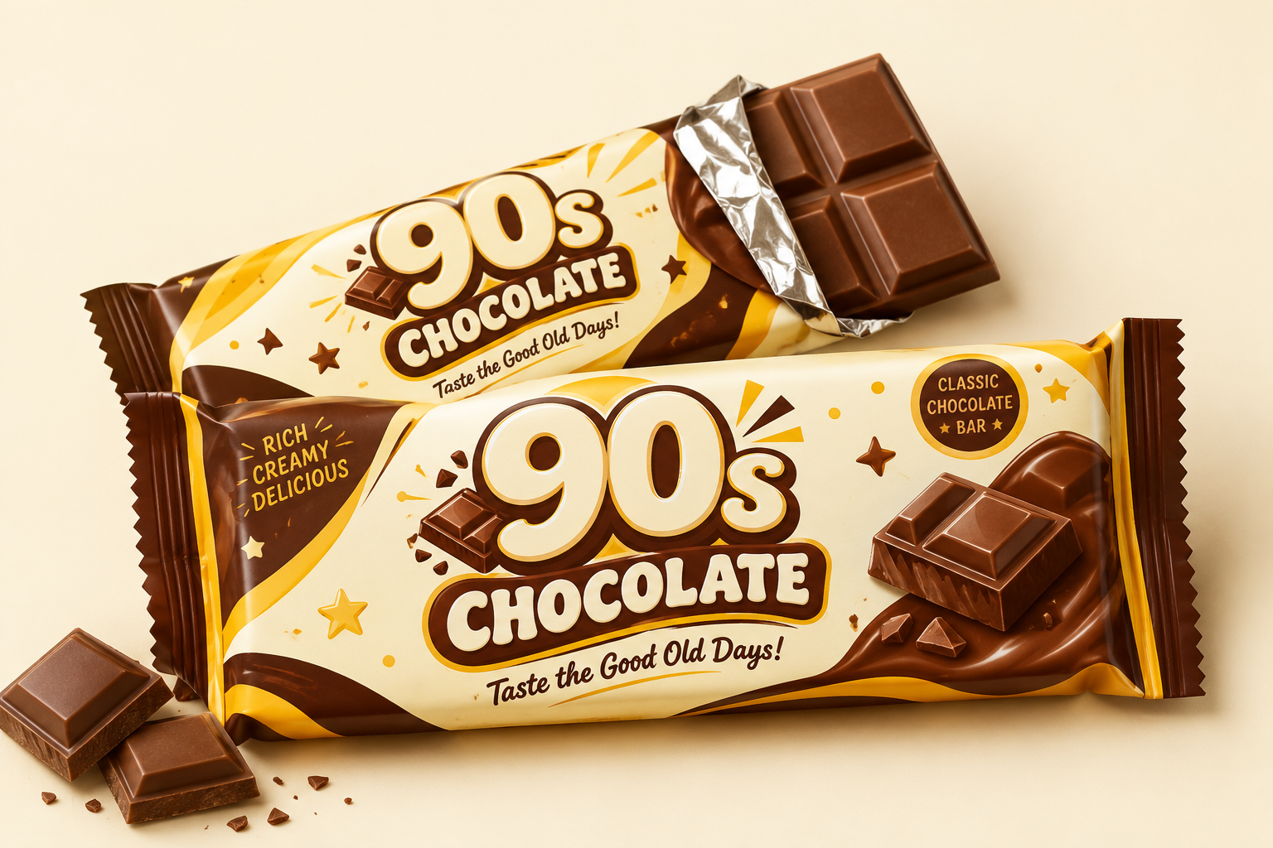
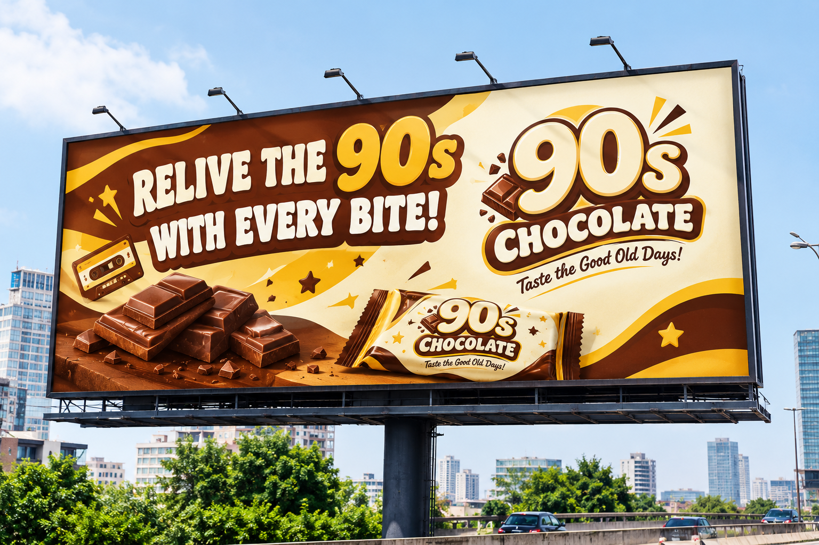
02 | AI BRAND IDENTITY KIT
Three matching designs for one consistent brand
1. Brand Logo
2. Chocolate Packaging
3. Billboard Advertisement
Bold retro “90s” typography
Tagline: Taste the Good Old Days!
Brown, cream and gold wrapper
Realistic chocolate product mockup
Headline: RELIVE THE 90s
WITH EVERY BITE!
Brand colours: Chocolate Brown • Cream • Golden Yellow • White
3

Slide 4
03 | VISUAL IDENTITY
Colour palette and design direction
Chocolate Brown
Cream
Golden Yellow
White
#5B2C1F
#FFF8EC
#D6A72C
#FFFFFF
Design idea: bold “90s” lettering, clean product photography, warm backgrounds, and readable text.
4

Slide 5
04 | SOCIAL MEDIA CREATIVE 1
Brand awareness
RELIVE THE 90s
WITH EVERY BITE!
Rediscover the joy of chocolate and make every moment sweeter.
90s Chocolate — Taste the Good Old Days!
Visual: Chocolate bar close-up; warm brown and cream background; brand name and slogan clearly visible.
#90sChocolate #ChocolateLovers #SweetMemories
5

Slide 6
05 | SOCIAL MEDIA CREATIVE 2
Student engagement
SMALL BITES.
BIG HAPPINESS!
Take a sweet break between classes with 90s Chocolate. Share the sweetness. Enjoy the moment!
Visual: Students on a campus break, chocolate packet in focus, friendly bright composition.
#90sChocolate #StudyBreak #ChocolateTime
6

Slide 7
06 | 30-SECOND ADVERTISEMENT
Short-form commercial script
0–5 sec
College friends walking / smiling
“Remember the simple joys?”
5–12 sec
Chocolate packet reveal
“90s Chocolate brings back the sweet feeling!”
12–20 sec
Friends sharing chocolate
“Share a bite and create happy memories with friends.”
20–26 sec
Product close-up
“A little chocolate, a lot of happiness!”
26–30 sec
Logo and slogan
“90s Chocolate — Taste the Good Old Days! Get yours today!”
7

Slide 8
07 | SEVEN-DAY CONTENT CALENDAR
A simple weekly posting plan
MON
Brand introduction
Awareness
TUE
Chocolate close-up Reel
Attention
WED
Product photos / highlights
Showcase
THU
Poll: favourite chocolate moment?
Engagement
FRI
Promotional offer post
Purchase intent
SAT
Friends sharing chocolate Reel
Campus connection
SUN
Weekly recap / thank-you
Loyalty
8

Slide 9
08 | 45-SECOND VIDEO STORYBOARD
Scene-by-scene video content
0–5 sec
College friends walking
“Remember the simple joys?”
5–10 sec
Chocolate packet close-up
“Meet 90s Chocolate!”
10–18 sec
Chocolate close-up shots
“Make every moment sweeter.”
18–27 sec
Friends sharing chocolate
“Share a bite. Share a memory.”
27–35 sec
Product packaging reveal
“A little chocolate, a lot of happiness.”
35–45 sec
Brand end card
“90s Chocolate — Taste the Good Old Days! Get yours today!”
9

Slide 10
09 | VIDEO PRODUCTION NOTES
How to turn the storyboard into a Reel
FORMAT
VISUALS
Vertical 9:16
• Chocolate close-ups
• Campus friendship
• Product reveal
DURATION
30–45 seconds
EDITING
TEXT
• Upbeat background music
• Smooth transitions
• Clear voice-over
Clear, readable titles
10

Slide 11
APPENDIX A | BRAND LOGO PROMPT
AI prompt
Create a professional brand logo for a fictional chocolate brand named “90s Chocolate”, inspired by the nostalgia, fun, and happiness of the 1990s. Use bold, playful retro typography, with “90s” as the main visual element and “CHOCOLATE” clearly displayed underneath. Use chocolate brown, cream, golden yellow, and white as the brand colours. Include subtle vintage-inspired graphic elements and a premium chocolate-inspired appearance.
Display the exact brand name “90s Chocolate” prominently and include the tagline “Taste the Good Old Days!” on a clean cream background. Make the logo memorable, youthful, friendly, and suitable for college students and young adults. Ensure the brand name and tagline are correctly spelled and readable.
11

Slide 12
APPENDIX B | CHOCOLATE PACKAGING PROMPT
AI prompt
Create a realistic chocolate bar packaging mockup for the fictional brand “90s Chocolate”, inspired by the 1990s. Design an attractive chocolate wrapper using chocolate brown, cream, golden yellow, and white. Place the exact “90s Chocolate” logo prominently on the front of the package and include the tagline “Taste the Good Old Days!”
Use bold retro typography, playful vintage patterns, nostalgic shapes, and appetising chocolate imagery. Show one fully wrapped chocolate bar alongside a partially unwrapped chocolate bar with a realistic chocolate texture. Use professional studio lighting, soft shadows, realistic packaging materials, and a clean cream background.
Maintain the same logo, brand name, colours, and typography as the brand logo design. Ensure the brand name and tagline are clearly visible and correctly spelled.
12

Slide 13
APPENDIX C | BILLBOARD PROMPT
AI prompt
Design a professional outdoor billboard advertisement for the fictional chocolate brand “90s Chocolate”. Use a bold, nostalgic 1990s-inspired design with chocolate brown, cream, golden yellow, and white.
Display the headline “RELIVE THE 90s WITH EVERY BITE!” in large, bold, readable retro typography. Feature an appetising chocolate bar with rich chocolate pieces. Place the exact “90s Chocolate” brand name and logo prominently on the billboard. Include the tagline “Taste the Good Old Days!”
Use high contrast, minimal text, a clean visual hierarchy, and an eye-catching composition that can be read from a distance. Present the design on a realistic large roadside billboard in a modern city during daylight. Keep the logo, colours, typography, and brand identity consistent with the chocolate packaging design.
13

